Slide 1
3. Morphology and
Finite-State Transducers

Slide 2
Morphology
Morphology in linguistics—and particularly in Natural Language Processing (NLP)—is the study of the structure and formation of words.
Morpheme --The smallest unit of meaning in a language (e.g., un, break, able)
Root/Stem---The core part of a word (e.g., play in playing)
Affix--Prefixes, suffixes, infixes, etc. that modify the root (e.g., -ing)
Inflection--Changes for tense, number, case, etc. (e.g., go → went)
DerivationCreating new words (e.g., happy → unhappiness)
Morphology and FSTs

Slide 3
Background
The problem of recognizing that foxes breaks down into the two morphemes fox and -es is called morphological parsing.
Similar problem in the information retrieval domain: stemming
Given the surface or input form going, we might want to produce the parsed form: VERB-go + GERUND-ing
In this Presentation we will discuss
  morphological knowledge and
  The finite-state transducer
It is quite inefficient to list all forms of noun and verb in the dictionary because of the productivity of the forms.
Morphological parsing is necessary more than just IR, but also
  Machine translation
  Spelling checking
Morphology and FSTs

Slide 4
Morphological Parsing
Parsing English morphology
Input | Morphological parsed output
cats cat cities geese goose gooses merging caught | cat +N +PL cat +N +SG city +N +PL goose +N +PL (goose +N +SG) or (goose +V) goose +V +3SG merge +V +PRES-PART (caught +V +PAST-PART) or (catch +V +PAST)
Stems and morphological features
Morphology and FSTs

Slide 5
3.1 Survey of (Mostly) English Morphology
Morphology is the study of the way in which the words are built up from smaller meaning-bearing units, morphemes. (study of meaningful components of a word)
Two broad classes of morphemes:
  The stems: the “main” morpheme of the word, supplying the main meaning, while
  The affixes: add “additional” meaning of various kinds.
Affixes are further divided into prefixes, suffixes, infixes, and circumfixes.
  Suffix: eat-s
  Prefix: un-buckle
  Circumfix: ge-sag-t (said) sagen (to say) (in German)
  Infix: hingi (borrow) humingi (the agent of an action) )in Philippine language Tagalog)
Morphology and FSTs

Slide 6
3.1 Survey of (Mostly) English Morphology
Prefixes and suffixes are often called concatenative morphology.
Two broad classes of ways to form words from morphemes:
  Inflection: the combination of a word stem with a grammatical morpheme, usually resulting in a word of the same class as the original term, and usually filling some syntactic function like agreement, and
  Derivation: the combination of a word stem with a grammatical morpheme, usually resulting in a word of a different class, often with a meaning hard to predict exactly.
Morphology and FSTs

Slide 7
3.1 Survey of (Mostly) English Morphology
Inflectional Morphology
In English, only nouns, verbs, and sometimes adjectives can be inflected, and the number of affixes is quite small.
Inflections of nouns in English:
  An affix marking plural,
    cat(-s), thrush(-es), ox (oxen), mouse (mice)
    ibis(-es), waltz(-es), finch(-es), box(-es), butterfly(-lies)
  An affix marking possessive
    llama’s, children’s, llamas’, Euripides’ comedies
Morphology and FSTs

Slide 8
3.1 Survey of (Mostly) English Morphology
Inflectional Morphology
Verbal inflection is more complicated than nominal inflection.
  English has three kinds of verbs:
    Main verbs, eat, sleep, impeach
    Modal verbs, can, will, should
    Primary verbs, be, have, do
  Morphological forms of regular verbs
stem | walk | merge | try | map
-s form | walks | merges | tries | maps
-ing participle | walking | merging | trying | mapping
Past form or –ed participle | walked | merged | tried | mapped
  These regular verbs and forms are significant in the morphology of English because of their majority and being productive.
Morphology and FSTs

Slide 9
3.1 Survey of (Mostly) English Morphology
Inflectional Morphology
  Morphological forms of irregular verbs
stem | eat | catch | cut
-s form | eats | catches | cuts
-ing participle | eating | catching | cutting
Past form | ate | caught | cut
–ed participle | eaten | caught | cut
Morphology and FSTs

Slide 10
3.1 Survey of (Mostly) English Morphology
Derivational Morphology
Nominalization in English:
  The formation of new nouns, often from verbs or adjectives
Suffix | Base Verb/Adjective | Derived Noun
-action | computerize (V) | computerization
-ee | appoint (V) | appointee
-er | kill (V) | killer
-ness | fuzzy (A) | fuzziness
  Adjectives derived from nouns or verbs
Suffix | Base Noun/Verb | Derived Adjective
-al | computation (N) | computational
-able | embrace (V) | embraceable
-less | clue (N) | clueless
Morphology and FSTs

Slide 11
3.2 Finite-State Morphological Parsing
Parsing English morphology
Input | Morphological parsed output
cats cat cities geese goose gooses merging caught | cat +N +PL cat +N +SG city +N +PL goose +N +PL (goose +N +SG) or (goose +V) goose +V +3SG merge +V +PRES-PART (caught +V +PAST-PART) or (catch +V +PAST)
Stems and morphological features
Morphology and FSTs

Slide 12
3.2 Finite-State Morphological Parsing
We need at least the following to build a morphological parser:
  Lexicon: the list of stems and affixes, together with basic information about them (Noun stem or Verb stem, etc.)
  Morphotactics: the model of morpheme ordering that explains which classes of morphemes can follow other classes of morphemes inside a word. E.g., the rule that English plural morpheme follows the noun rather than preceding it.
  Orthographic rules: these spelling rules are used to model the changes that occur in a word, usually when two morphemes combine (e.g., the y→ie spelling rule changes city + -s to cities).
Morphology and FSTs

Slide 13
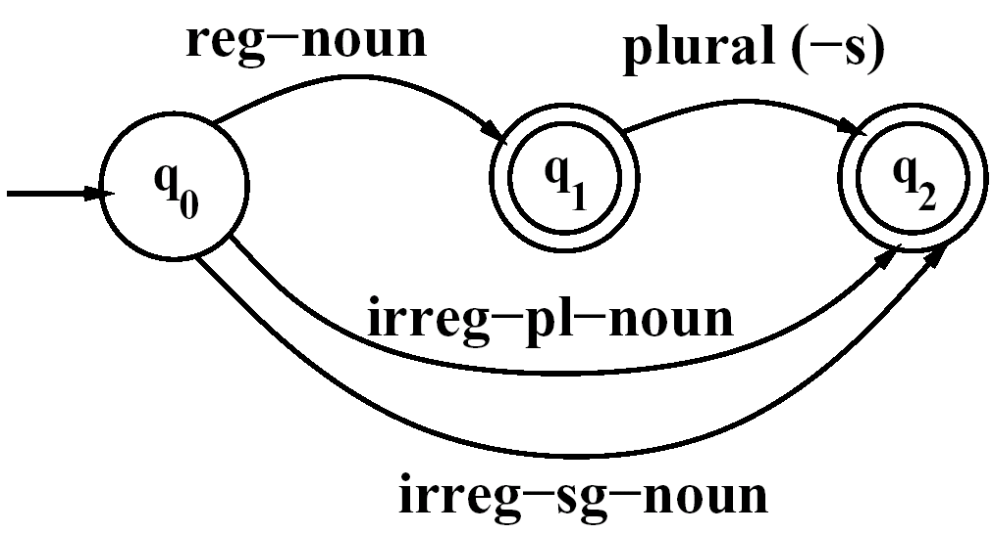
3.2 Finite-State Morphological Parsing
The Lexicon and Morphotactics
A lexicon is a repository for words.
  The simplest one would consist of an explicit list of every word of the language. Incovenient or impossible!
  Computational lexicons are usually structured with
    a list of each of the stems and
    Affixes of the language together with a representation of morphotactics telling us how they can fit together.
  The most common way of modeling morphotactics is the finite-state automaton.
Reg-noun | Irreg-pl-noun | Irreg-sg-noun | plural
fox flower bus | geese sheep Mice | goose sheep mouse | -s
An FSA for English nominal inflection
Morphology and FSTs

Slide 14
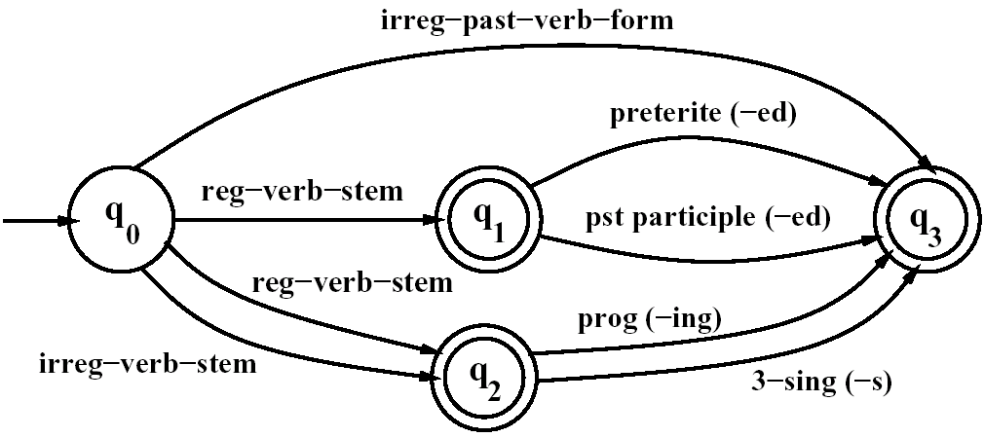
3.2 Finite-State Morphological Parsing
The Lexicon and Morphotactics
An FSA for English verbal inflection
Reg-verb-stem | Irreg-verb-stem | Irreg-past-verb | past | Past-part | Pres-part | 3sg
walk fry talk impeach | cut speak sing sang spoken | caught ate eaten | -ed | -ed | -ing | -s
Morphology and FSTs

Slide 15
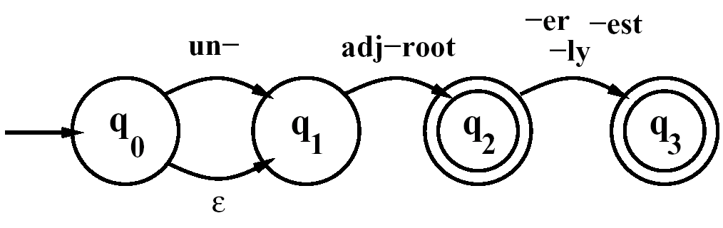
3.2 Finite-State Morphological Parsing
The Lexicon and Morphotactics
A small part of morphosyntactics of English adjectives
big, bigger, biggest
cool, cooler, coolest, coolly
red, redder, reddest
clear, clearer, clearest, clearly, unclear, unclearly
happy, happier, happiest, happily
unhappy, unhappier, unhappiest, unhappily
real, unreal, really
An FSA for a fragment of English adjective
Morphology #1
Morphology and FSTs

Slide 16
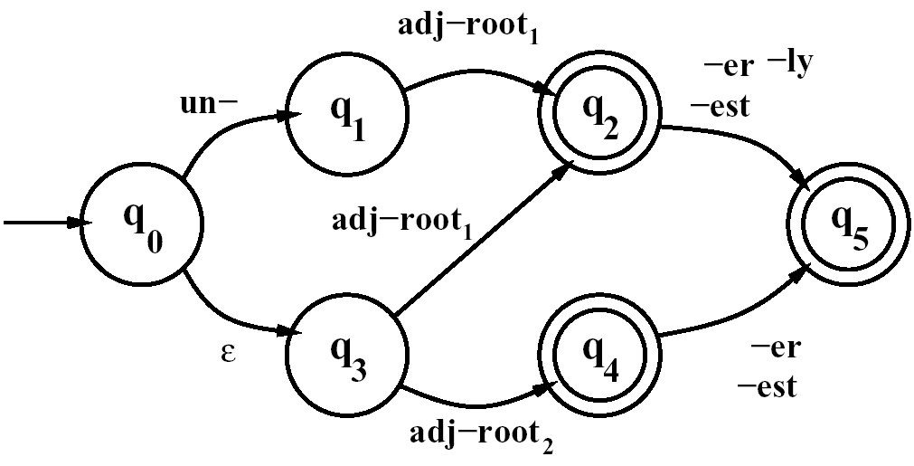
3.2 Finite-State Morphological Parsing
The FSA#1 recognizes all the listed adjectives, and ungrammatical forms like unbig, redly, and realest.
Thus #1 is revised to become #2. (adj-root1: clear, happy, real)
(adj-root2 : big, cool, red)
The complexity is expected from English derivation.
An FSA for a fragment of English adjective
Morphology #2
Morphology and FSTs

Slide 17
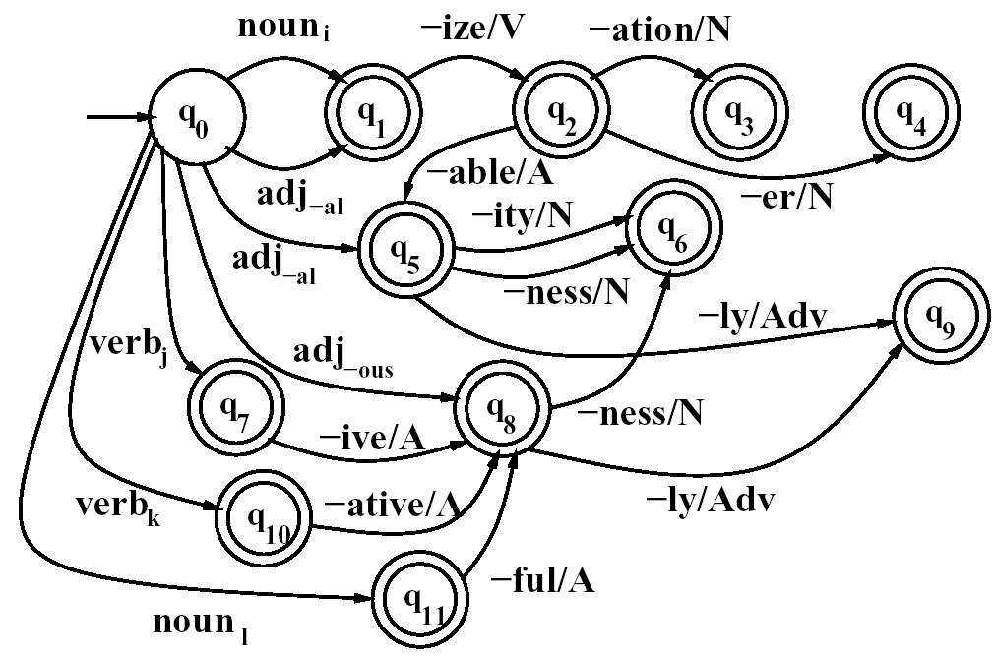
3.2 Finite-State Morphological Parsing
An FSA for another fragment of English derivational morphology
Morphology and FSTs

Slide 18
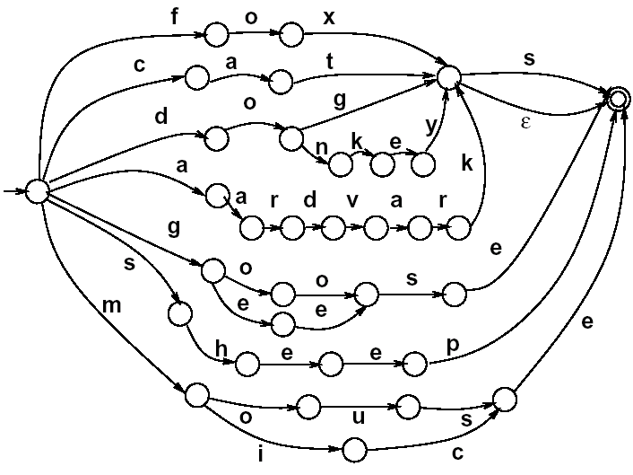
3.2 Finite-State Morphological Parsing
We can now use these FSAs to solve the problem of morphological recognition:
  Determining whether an input string of letters makes up a legitimate English word or not
  We do this by taking the morphotactic FSAs, and plugging in each “sub-lexicon” into the FSA.
  The resulting FSA can then be defined as the level of the individual letter.
Morphology and FSTs

Slide 19
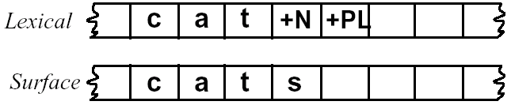
3.2 Finite-State Morphological Parsing
Morphological Parsing with FST
Given the input, for example, cats, we would like to produce cat +N +PL.
Two-level morphology, by Koskenniemi (1983)
  Representing a word as a correspondence between a lexical level
    Representing a simple concatenation of morphemes making up a word, and
  The surface level
    Representing the actual spelling of the final word.
Morphological parsing is implemented by building mapping rules that maps letter sequences like cats on the surface level into morpheme and features sequence like cat +N +PL on the lexical level.
Morphology and FSTs

Slide 20
3.2 Finite-State Morphological Parsing
Morphological Parsing with FST
The automaton we use for performing the mapping between these two levels is the finite-state transducer or FST.
  A transducer maps between one set of symbols and another;
  An FST does this via a finite automaton.
Thus an FST can be seen as a two-tape automaton which recognizes or generates pairs of strings.
The FST has a more general function than an FSA:
  An FSA defines a formal language
  An FST defines a relation between sets of strings.
Another view of an FST:
  A machine reads one string and generates another.
Morphology and FSTs

Slide 21
3.2 Finite-State Morphological Parsing
Morphological Parsing with FST
A formal definition of FST (based on the Mealy machine extension to a simple FSA):
  Q: a finite set of N states q₀, q₁,…, q_{N}
  Σ: a finite alphabet of complex symbols. Each complex symbol is composed of an input-output pair i : o; one symbol I from an input alphabet I, and one symbol o from an output alphabet O, thus Σ ⊆ I×O. I and O may each also include the epsilon symbol ε.
  q₀: the start state
  F: the set of final states, F ⊆ Q
  δ(q, i:o): the transition function or transition matrix between states. Given a state q ∈ Q and complex symbol i:o ∈ Σ, δ(q, i:o) returns a new state q’ ∈ Q. δ is thus a relation from Q × Σ to Q.
Morphology and FSTs

Slide 22
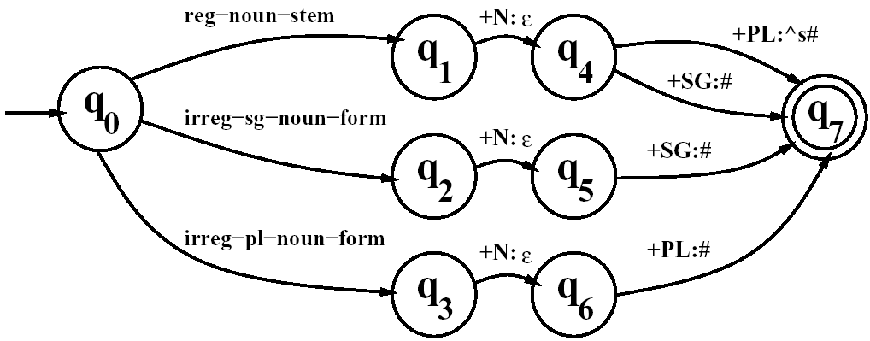
3.2 Finite-State Morphological Parsing
Morphological Parsing with FST
Reg-noun | Irreg-pl-noun | Irreg-sg-noun
fox fat fog aardvark | g o:e o:e s e sheep m o:i u:εs:c e | goose sheep mouse
A transducer for English nominal
number inflection T_{num}
Morphology and FSTs

Slide 23
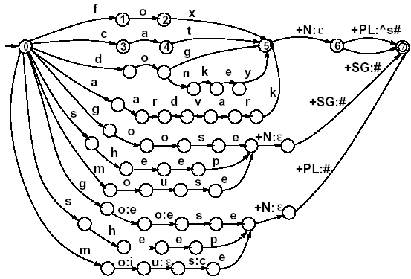
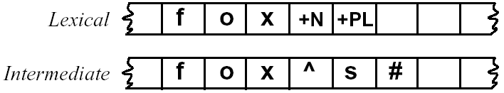
3.2 Finite-State Morphological Parsing
Morphological Parsing with FST
^: morpheme boundary
#: word boundary
An English nominal inflection FST
Morphology and FSTs

Slide 24
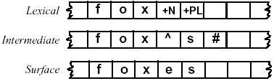
3.2 Finite-State Morphological Parsing
Orthographic Rules and FSTs
Spelling rules (or orthographic rules)
Name | Description of Rule | Example
Consonant doubling E deletion E insertion Y replacement K insertion | 1-letter consonant doubled before -ing/-ed Silent e dropped before -ing and -ed e added after -s, -z, -x, -ch, -sh, before -s -y changes to -ie before -s, -i before -ed Verb ending with vowel + -c add -k | beg/begging make/making watch/watches try/tries panic/panicked
  These spelling changes can be thought as taking as input a simple concatenation of morphemes and producing as output a slightly-modified concatenation of morphemes.
Morphology and FSTs

